Slide 2
Abstarct
Efficient and accurate object detection has been an important topic in the advancement of computer vision systems. With the advent of deep learning techniques, the accuracy for object detection has increased drastically. The project aims to incorporate state-of-the-art technique for object detection with the goal of achieving high accuracy with a real-time performance. A major challenge in many of the object detection systems is the dependency on other computer vision techniques for helping the deep learning based approach, which leads to slow and non-optimal performance. In this project, we use a completely deep
learning based approach to solve the problem of object detection in an end-to-end fashion. The network is trained on the most challenging publicly available dataset (PASCAL VOC), on which a object detection challenge is conducted annually. The resulting system is fast and accurate, thus aiding those applications which require object detection.

Slide 3
Existing System
There has been a lot of work in object detection using traditional computer vision techniques (sliding windows, deformable part models). However, they lack the accuracy of deep learning based techniques. Among the deep learning based techniques, two broad class of methods
are prevalent: two stage detection (RCNN [1], Fast RCNN [2], Faster RCNN [3]) and unified detection (Yolo [4], SSD [5]). The major concepts involved in these techniques have been explained below.

Slide 4
Proposed System
Many problems in computer vision were saturating on their accuracy before a decade. However, with the rise of deep learning techniques, the accuracy of these problems drastically improved. One of the major problem was that of image classification, which is defined as
predicting the class of the image. A slightly complicated problem is that of image localization, where the image contains a single object and the system should predict the class of the location of the object in the image (a bounding box around the object). The more complicated problem (this project), of object detection involves both classification and localization.
In this case, the input to the system will be a image, and the output will be a bounding box corresponding to all the objects in the image, along with the class of object in each box.

Slide 5
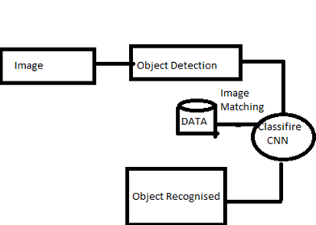
Architecture

Slide 6
Modules:
Bounding Box
The bounding box is a rectangle drawn on the image which tightly fits the object in the image. A bounding box exists for every instance of every object in the image. For the box, 4 numbers (center x, center y, width, height) are predicted. This can be trained using a distance measure between predicted and ground truth bounding box.
Classification
The bounding box is predicted using regression and the class within the bounding box is predicted using classification.

Slide 7
Moduls
Two stage method
In this case, the proposals are extracted using some other computer vision technique and then resized to fixed input for the classification network, which acts as a feature extractor. Then an SVM is trained to classify between object and background (one SVM for each class). Also a bounding box regressor is trained that outputs some some correction (offsets)
for proposal boxes.
Unified method
The difference here is that instead of producing proposals, pre-define a set of boxes to look for objects. Using convolutional feature maps from later layers of the network, run another network over these feature maps to predict class scores and bounding box offsets.

Slide 8
Conclusion:
An accurate and efficient object detection system has been developed which achieves comparable metrics with the existing state-of-the-art system. This project uses recent techniques in the field of computer vision and deep learning. Custom dataset was created using labelImgand the evaluation was consistent. This can be used in real-time applications which require object detection for pre-processing in their pipeline.
An important scope would be to train the system on a video sequence for usage in tracking applications. Addition of a temporally consistent network would enable smooth detection and more optimal than per-frame detection.

